Slide 1



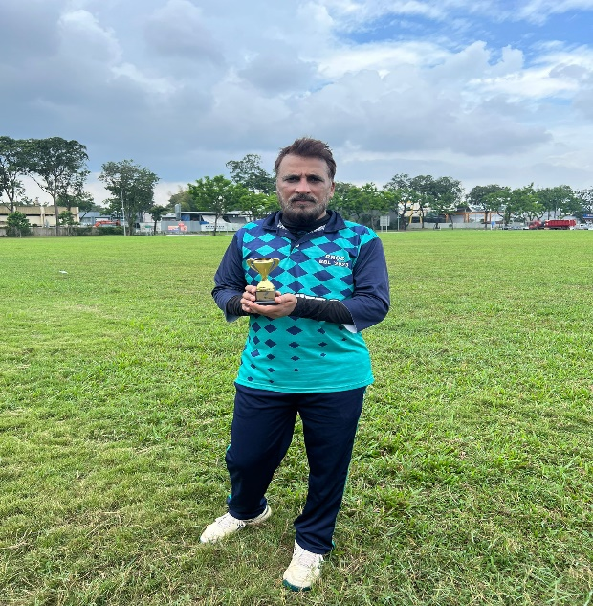






RIVERVALE ROCKETS CRICKET CLUB RIVERVALE ROCKETS CRICKET CLUB RIVERVALE ROCKETS CRICKET CLUB RIVERVALE ROCKETS CRICKET CLUB RIVERVALE ROCKETS CRICKET CLUB RIVERVALE ROCKETS CRICKET CLUB RIVERVALE ROCKETS CRICKET CLUB RIVERVALE ROCKETS CRICKET CLUB
SCORE
CUP
OVERS
8
4
BALLS
MAIDEN
13
1
FOUR’S
RUNS
0
20
SIXES’S
Rocket Singh of the Match
WICKETS
0
NADEEM IQBAL
4
Astonishers vs Adra Sakka
20-Aug-2023
RIVERVALE ROCKETS CRICKET CLUB RIVERVALE ROCKETS CRICKET CLUB RIVERVALE ROCKETS CRICKET CLUB RIVERVALE ROCKETS CRICKET CLUB RIVERVALE ROCKETS CRICKET CLUB RIVERVALE ROCKETS CRICKET CLUB RIVERVALE ROCKETS CRICKET CLUB RIVERVALE ROCKETS CRICKET CLUB

